Slide 1

AUTOSHARK
DEVELOPERS: RAZU ALI, AHSAN KHAN
07.19.2021

Slide 2
INTRODUCTION
WHO ARE WE???
WHAT DO WE DO???
WHAT DID WE CREATE???
AHSAN KHAN
RAZU ALI
STUDENTS AT FULLSTACK ACADEMY
CREATED AUTOSHARK TO AUTOMATE THE LOGS ANALYSIS

Slide 3
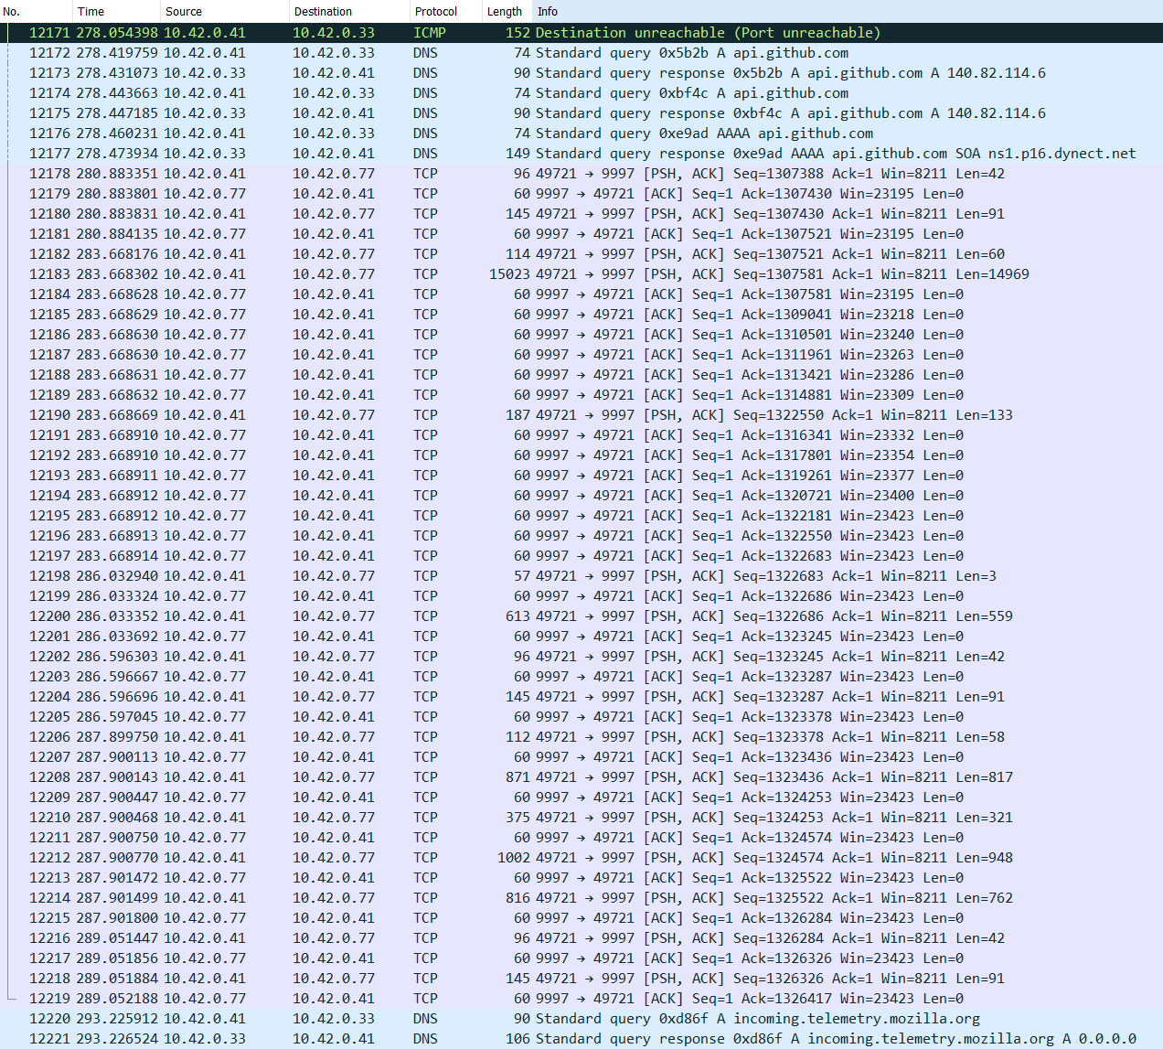

How Wireshark is a great tool, but time consuming!!!
Would you rather go over 12000+ Packets to find a nmap scan???
OR
Let a tool do it for you, so you can target specific packets, only???
HIGHLIGHT THE PROBLEMS
1. Time Consuming
2. Too Many Packets To Find The Information Manually
3. No Option To Zoom In, Strenuous To The Viewer(s)
4. Does Not Automatically Detect Malicious Activities

Slide 4
autoshark?
What is AutoShark?
MODULES USED
PyShark | Sys | Re | Scapy
This module was used to detect IoCs in the PCAP file. | This module was used to store the file that is being passed through our program. | Re expressions were used to search through the PCAP file to find certain patterns. | Scapy was used to read the PCAP and parse through the PCAP file.
Allowing python packet parsing. | Provides access to some variables used or maintained by the interpreter and to functions that interact strongly with the interpreter. | Provides regular expression matching operations like those found in Perl. | Program that enables the user to send, sniff and dissect and forge network packet
AutoShark is a command line tool that automates the parsing of a logs file. You can use AutoShark to extract all the IP addresses (and its relevant data), all types of file found in a PCAP file, and an option that would tell you all the Indicator of compromise(s).

Slide 5
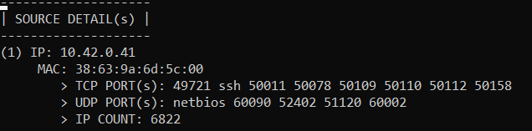
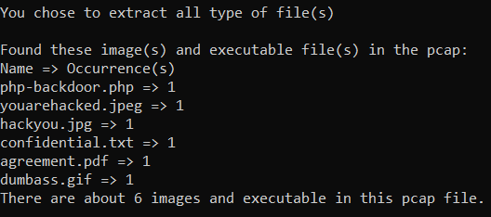

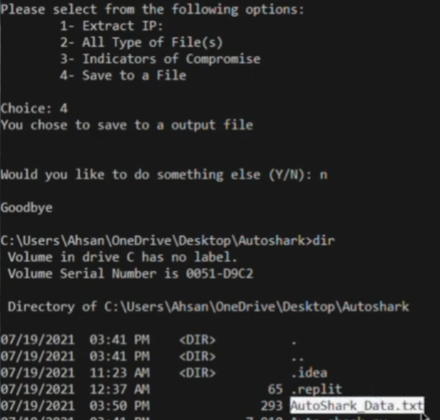
WHAT CAN YOU DO WITH AUTOSHARK?
1. Extract IP Summary | You can use this option to extract all the IP addresses from a PCAP file, the MAC address linked with that IP Address, and all the TCP/UDP Ports found.
2. ALL TYPES OF FILE(S) | This option will display you all the files found in a PCAP file. Files that may be sent by an attacker or by the victim.
3. Indicator of Compromise | You can use this option to extract all the IP addresses from a PCAP file, the MAC address linked with that IP Address, and all the TCP/UDP Ports found.
4. Save it to a file | This option can be used to save all the data to a file, this way you do no have to run the code again and again.

Slide 6


THANK YOU
RAZU ALI
AHSAN KHAN
https://github.com/Razua9617/Auto_shark

